Slide 1
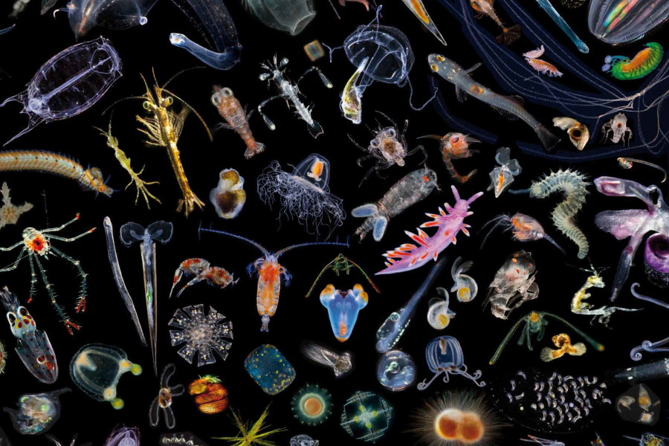
Tiny Dancers
Diving into Plankton for Oceans Day!

Slide 2
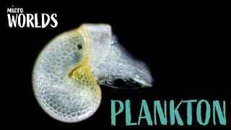
Notes:
Link to Video: https://www.youtube.com/embed/yS1Rk4CMpSE

Slide 3

Notes:
Link to video: https://www.youtube.com/embed/wtq7hvjgkh4

Slide 4


Questions to Investigate:
What are plankton?
If you were a plankter, what would you eat?
How would you move?
Notes:
Introduce Questions to Investigate
Image Source:
Question Mark: https://www.seekpng.com/png/detail/9-98301_png-question-marks-transparent-background-question-mark-clipart.png

Slide 5



I can think critically about what features help an organism survive in the ocean.
I can differentiate between a zooplankton and a phytoplankton.
I can describe an autotroph and a heterotroph.
Learning Goals
Choose 1 to Focus on Today

Slide 6
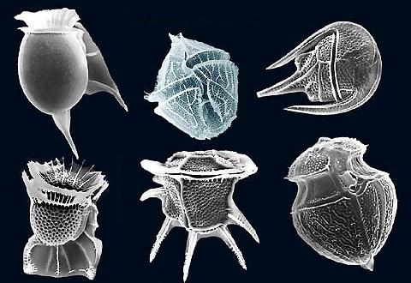
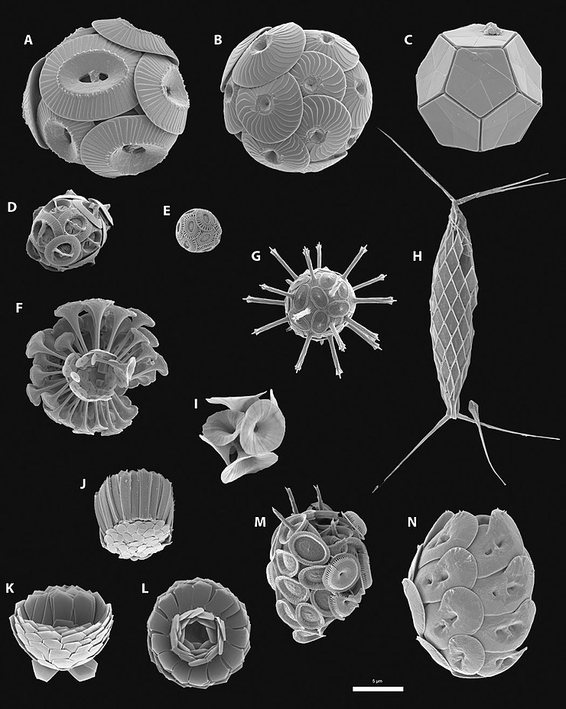
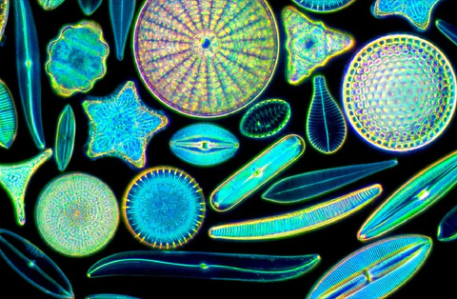
Phytoplankton Examples
https://moticmicroscopes.com/blogs/articles/diatoms-nature-s-jewels-viewed-with-a-microscope
https://byjus.com/neet/dinoflagellates/
Diatoms
Dinoflagellates
Coccolithophores

Slide 7
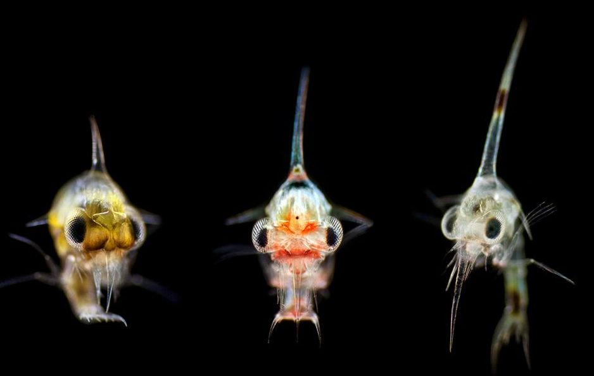
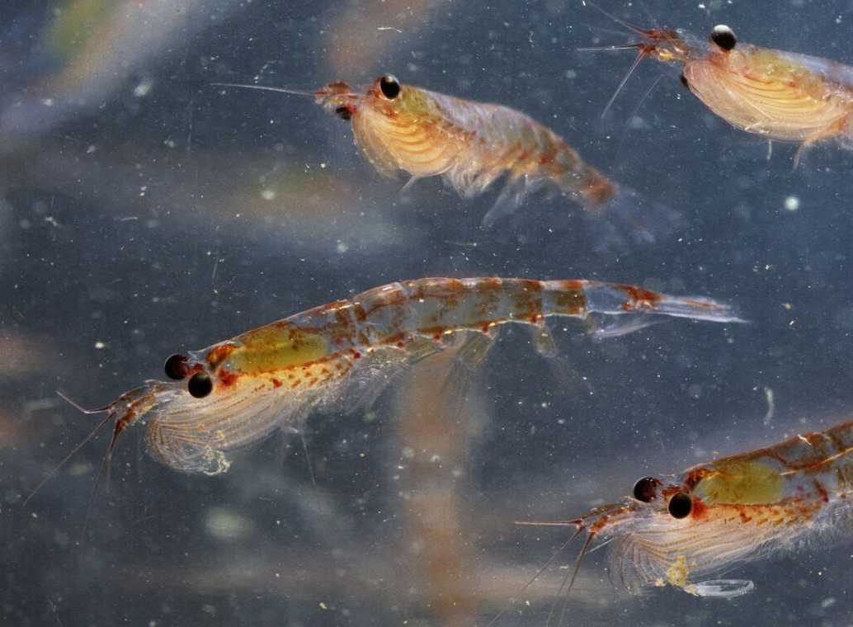
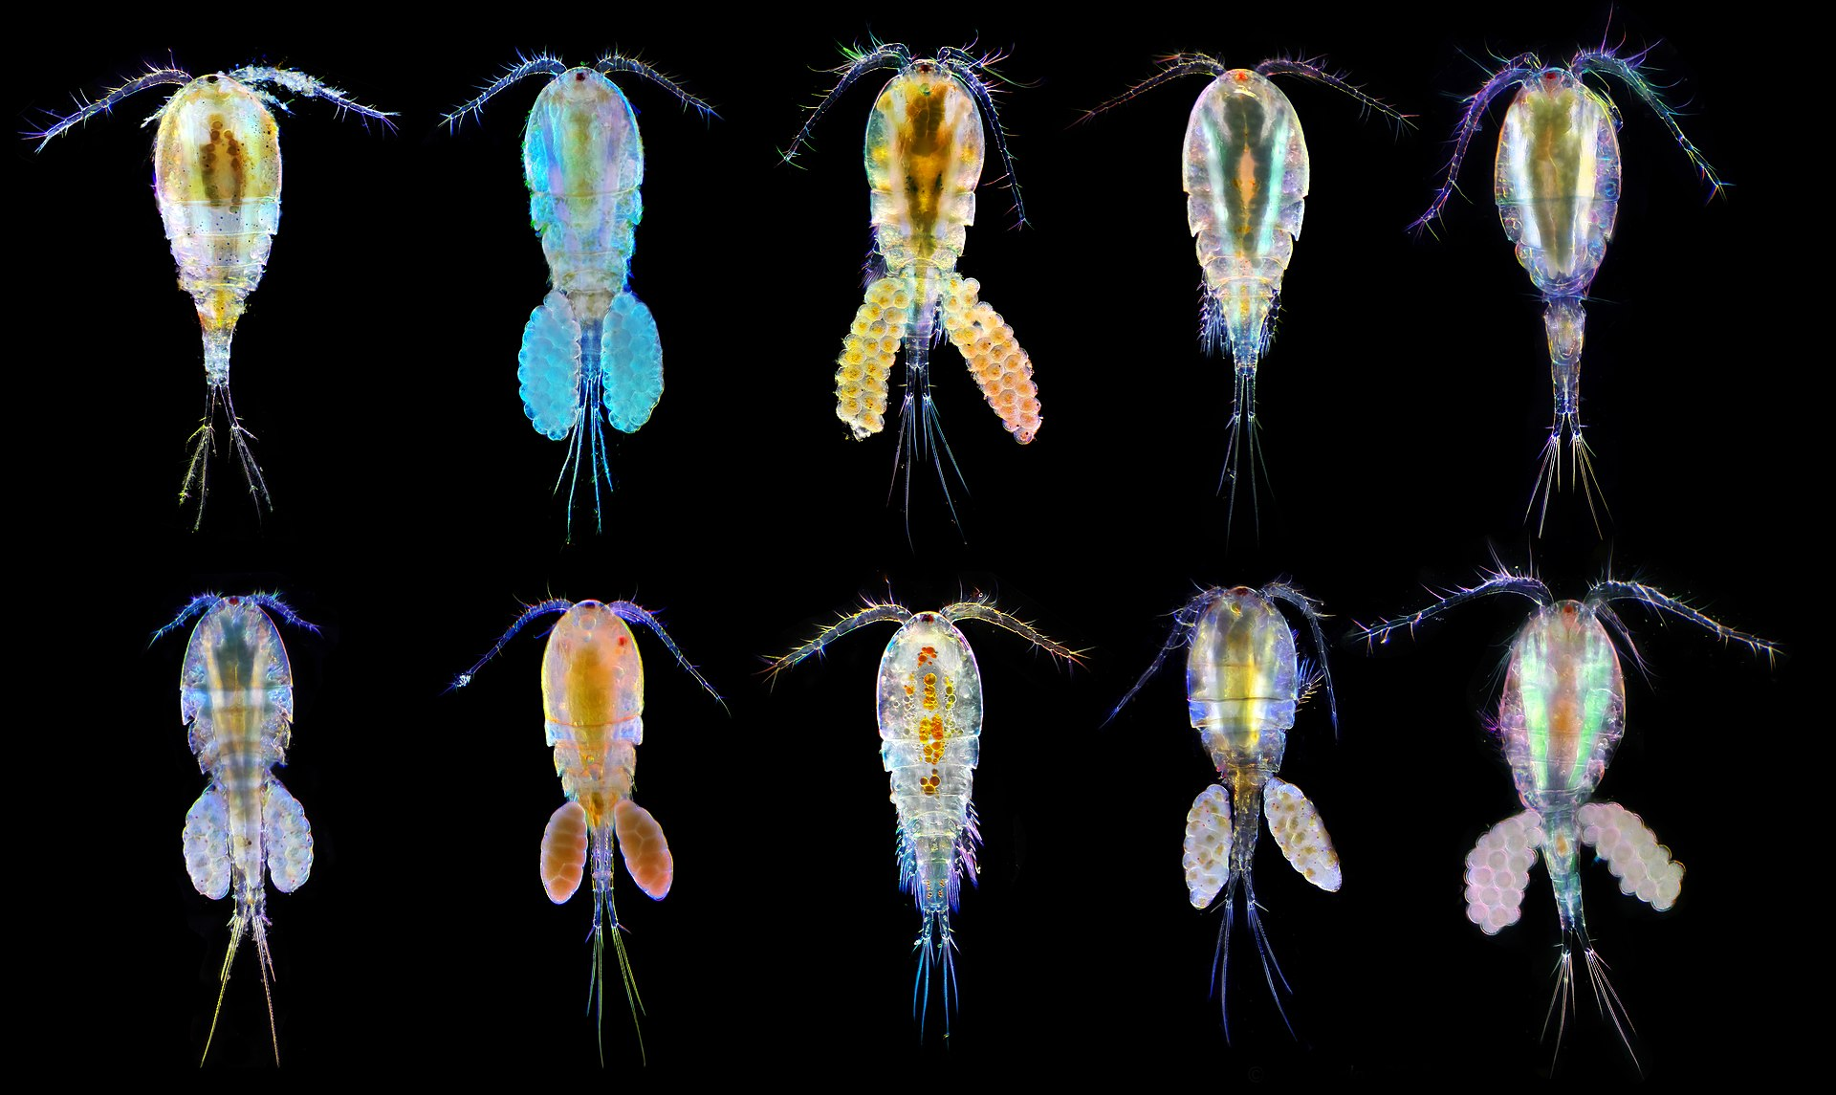
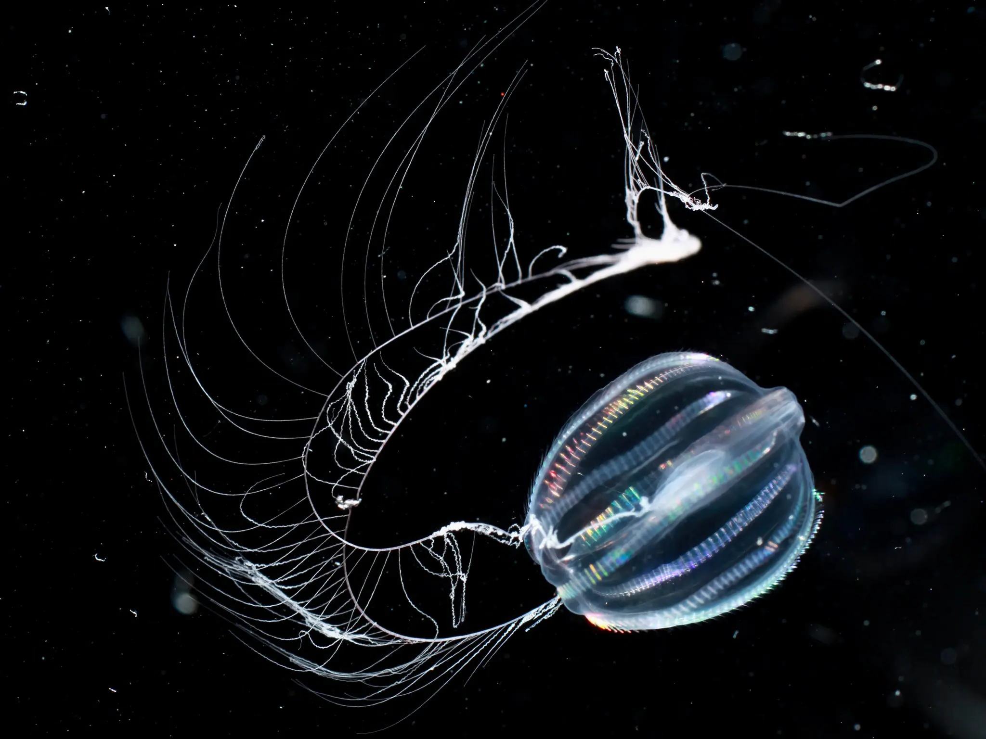
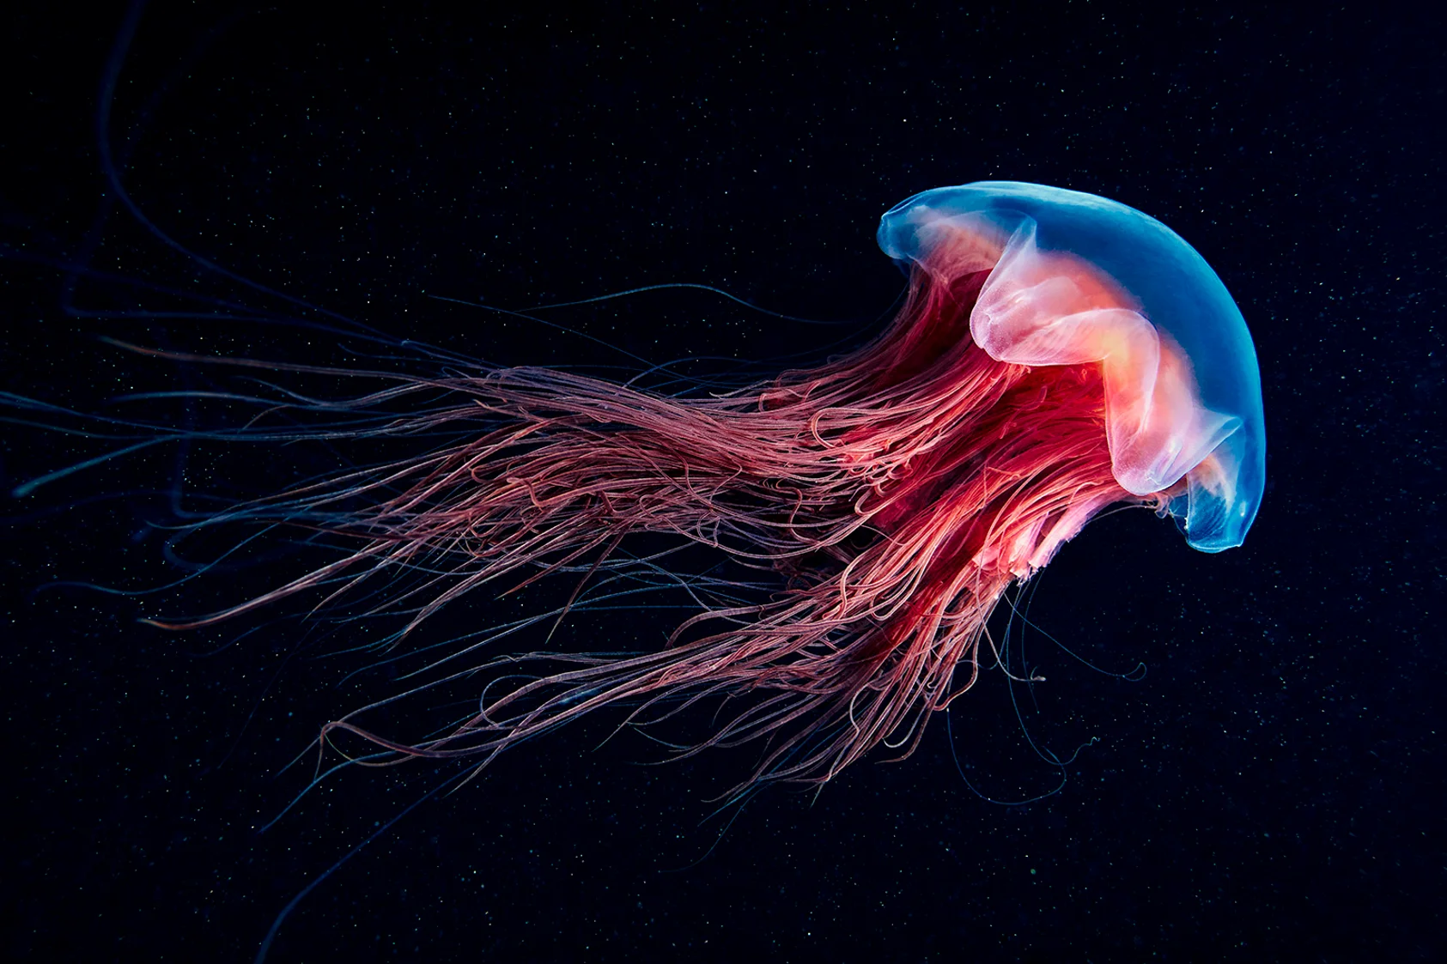
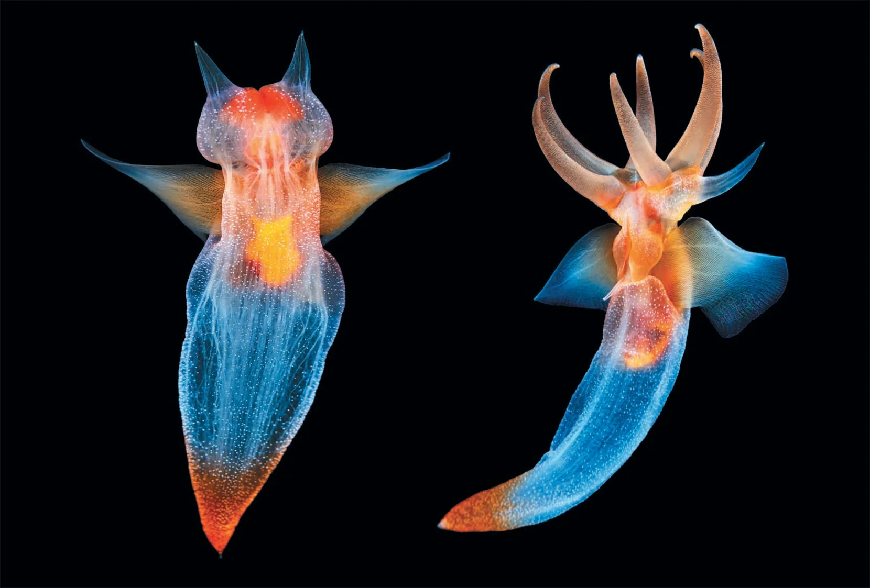
Zooplankton Examples
Zoea - crab larvae
Krill
Copepods
https://www.scientificamerican.com/article/see-iridescent-jellyfish-and-glowing-wonders-of-the-sea-in-world-oceans-day-photos/
https://www.scientificamerican.com/article/fantastic-sea-creatures-photographed-up-close-and-personal/
Jellyfish
Sea Angel
Ctenophore

Slide 8
Plankton Video Playlist

Slide 9
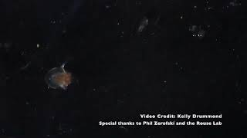
Plankton from La Jolla under a microscope

Slide 10
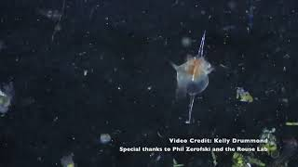
Plankton from La Jolla under a microscope

Slide 11
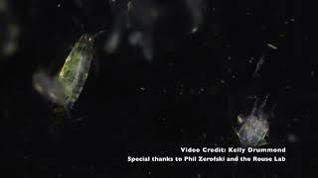
Plankton from La Jolla under a microscope

Slide 12
Exit Ticket
What did you enjoy most about this lesson?
Drag a Circle Over the Emoji That Best Shows How You Feel About Each Goal
I can think critically about what features help an organism survive in the ocean. | 🤔 | 😐 | 🙂 | 🤩
I can differentiate between a zooplankton and a phytoplankton. | 🤔 | 😐 | 🙂 | 🤩
I can describe an autotroph and a heterotroph. | 🤔 | 😐 | 🙂 | 🤩
What support would you like to feel more successful?
Notes:
Sample exit ticket for student feedback.

